Slide 1
Oregon city
planning commission
work session
Introduction to transportation engineering and community planning
Reah flisakowski
transportation engineer
rlf@dksassociates.com
503.243.3500

Slide 2
agenda
/ team Introduction
/ long-term transportation planning
/ transportation analysis for development review

Slide 3
Team introduction

Slide 4
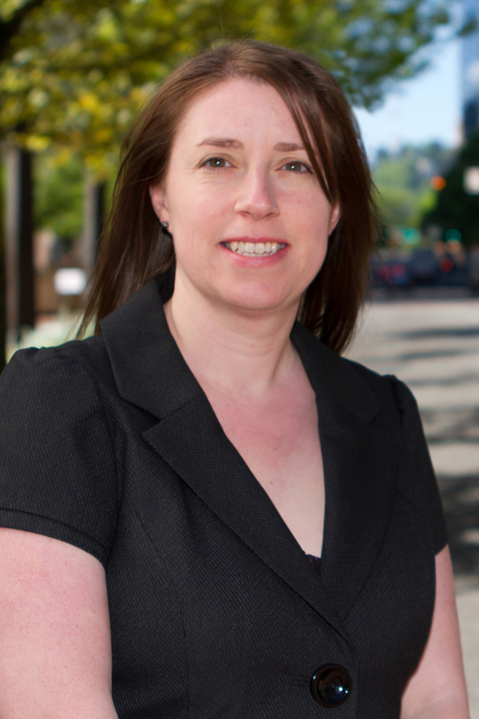
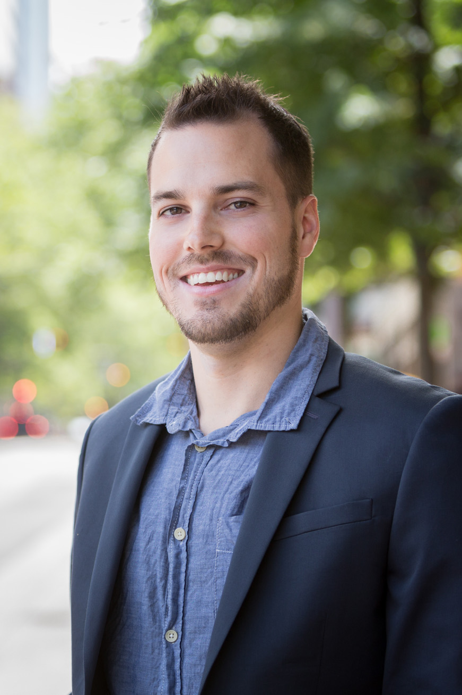
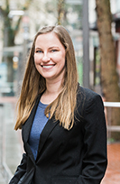
DKS support staff
Reah Flisakowski, PE
Senior transportation engineer
B.S. civil engineering
23 Years Experience at DKS
on-call development review services multiple agencies and long-range community planning
Kevin chewuk, PTP
Senior transportation planner
B.S. transportation planning, M.S Urban & regional planning
14 Years Experience at DKS
on-call development review services multiple agencies
Oregon City TSP, SDC update, several local plans
Amanda deering, PE
transportation engineer
B.S/M.S. civil engineering
6 Years Experience at DKS
on-call development review services multiple agencies
Thimble creek concept plan, I-205 tolling review
4
Oregon city planning commission work session

Slide 5
long-term transportation planning

Slide 6
Transportation plans
Identify policies and projects in Oregon City:
Oregon Highway Plan, Oregon Transportation Commission
Oregon Transportation Planning Rule
Metro Regional Transportation Plan
Clackamas County Transportation System Plan
Oregon City Transportation System Plan
Oregon city planning commission work session
6

Slide 7
planning context
Oregon City TSP Goals
Enhance health and safety for residents
Emphasize effective and efficient management of the system
Foster a sustainable system
Provide an equitable, balanced and connected multimodal system
Identify solutions and funding to meet needs
Increase the convenience and availability of pedestrian, bicycle and transit modes
Ensure the system supports a prosperous and competitive economy
Comply with state and regional plans
Comprehensive Plan vision for 2040
Healthy and welcoming community
Diverse economy
Connected infrastructure
Protected environment
Oregon city planning commission work session
7

Slide 8
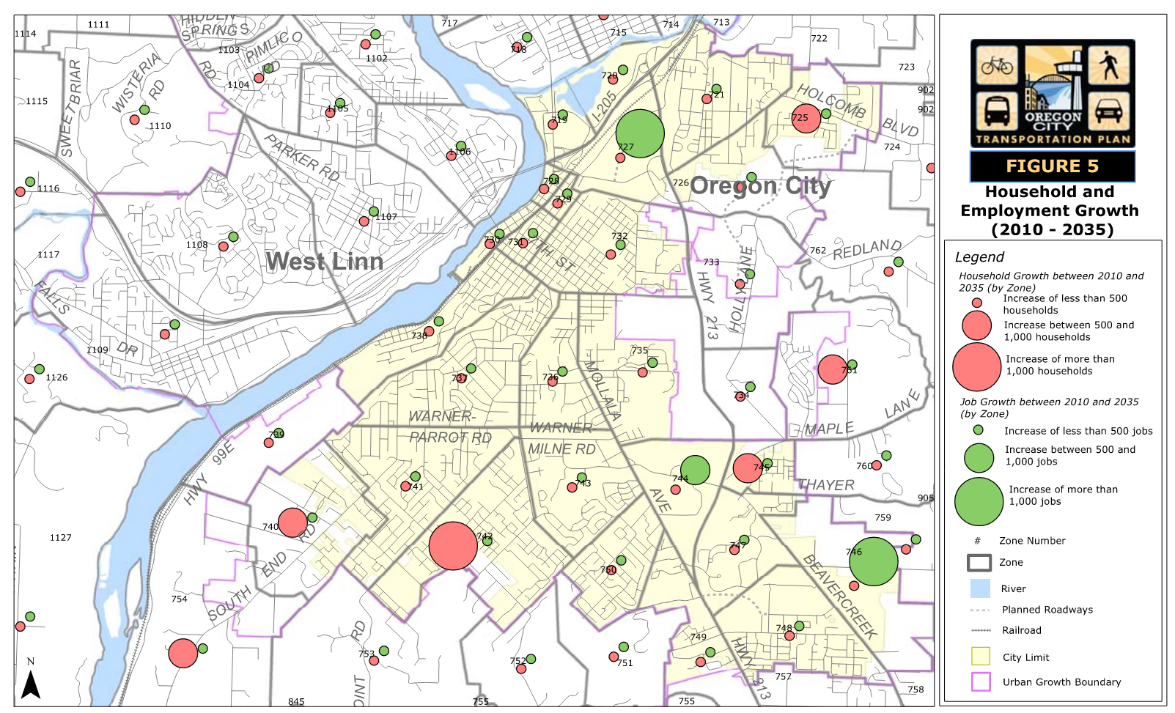
estimated growth
TSP addresses long-range system needs across the city
Development review addresses short-term impacts in local area
Source: City of Oregon city tsp – based on population and metro land use forecasts
Oregon city planning commission work session
8

Slide 9
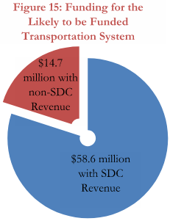
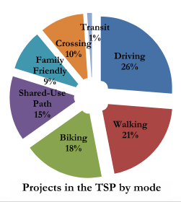
Outcomes of the tsp
Regulations
Goals and Policies
Design Standards
Development Code
Projects ($200M+)
Master Plans for all modes of travel with priorities
Funding ($73M)
Gas Tax Revenues
System Development Charges
Development Contributions
New Vehicle Registration Fee
80%
Oregon city planning commission work session
13

Slide 10
Transportation analysis for development review

Slide 11
Transportation impact study (TIS)
Transportation analyses are required to provide an objective assessment of potential impacts from a specific land use action (development application, zone change or comp plan amendment).
Key Questions to Answer with TIS:
Will the existing system accommodate the proposed development from a vehicle operation and safety standpoint?
How will study intersections operate relative to the City’s mobility standards?
What on-site and off-site improvements will be necessary to support the development? Are they TSP projects?
How will access to the development affect nearby traffic operations?
How will the development ensure safe and efficient circulation on and adjacent to the project site?
How will the development provide needed walking, biking, transit and driving connections to adjacent parcels?
Oregon city planning commission work session
11

Slide 12
TIS Guidelines and procedures
General Steps to Conduct a TIS:
Determine scope of analysis
study locations (arterial and/or collector intersection, add 20+ trips/hour)
Year of opening (or phases) and time of day
Evaluate system performance
Data collection – intersection counts, system inventory
Estimate new trips, evaluate intersection operations, need for new connections, safety issues, evaluate site access
Compare conditions without and with development to measure impact
Recommend mitigations to address impact if standards are not met
Construct off-site improvement (intersection capacity)
Construct improvements along the site frontage
Pay fees toward planned system improvements (SDC, proportionate share)
Oregon city planning commission work session
12

Slide 13
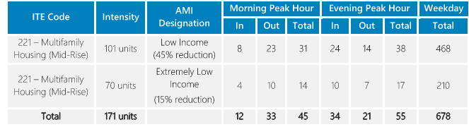
trip generation
Estimate New Trips
ITE trip rates based on national surveys
Land use categories for all types of development (recent update)
Development size (building square-foot, housing units)
Rates for peak hour and daily trips
Allowable trip reductions – mixed use, low income
Oregon city planning commission work session
13

Slide 14
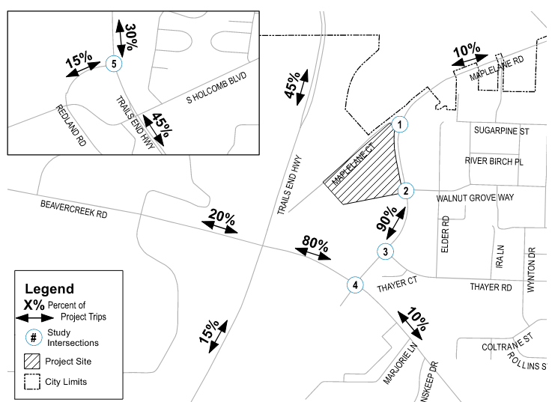
Intersection volumes
Estimate Where New Trips will Travel
Local knowledge and travel forecast model
Percentage assigned to nearby system
New trips added to study intersections
Estimate Background Growth
In-process trips approved by City but not constructed
Trips from growth outside City
Oregon city planning commission work session
14

Slide 15
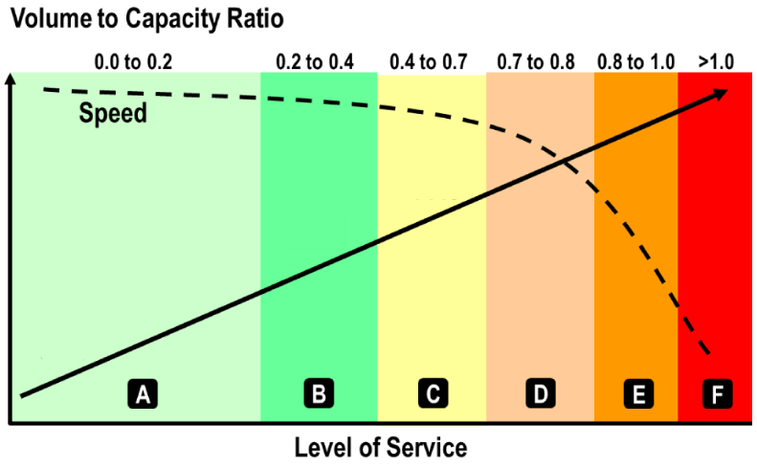
Mobility standards
Evaluating Intersection Operations – Is there an impact?
Level of service (LOS) measures intersection vehicle delay (LOS A to F)
Volume-to-capacity ratio (v/c) measures how much capacity is used (0 to 1.0)
Different standards for control type (signal, unsignalized) and location (Metro RTP arterial and OC Regional Center)
During evening peak hour: LOS D at OR 213/Molalla Ave/Douglas Loop and LOS F at OR 213/Beavercreek Rd
Oregon city planning commission work session
15

Slide 16
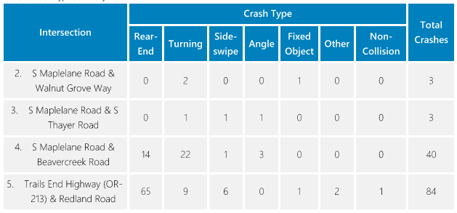
Safety assessment
Evaluate historical collision data (last 4 years) at study intersections
Identify collision trends and potential safety issues with adding new trips
Oregon city planning commission work session
16

Slide 17
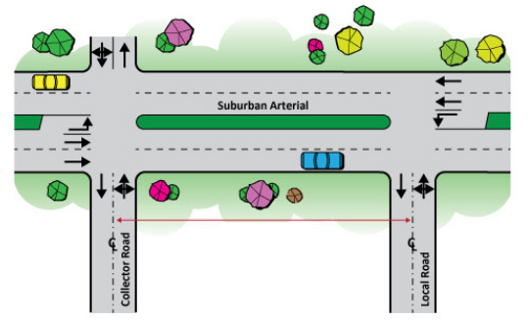
Access evaluation
Access Spacing Standards
Based on functional classification and fronting land use (residential, commercial, industrial)
Maximum and minimum block length and intersection spacing, minimum driveway spacing, minimum traffic signal spacing
Sight Distance Standards
Based on travel speeds and on-site measurements
Oregon city planning commission work session
17

Slide 18
Conditions of approval
If new trips are expected to impact vehicle operations or safety and standards are not met, the development is responsible to mitigate the impact
Common mitigations:
Offsite intersection capacity improvement (turn lane, signal)
Provide street stub to adjacent property
Relocate access location or restrict access (right in/right out)
Needs to be proportional to the impact
Is the capacity or safety need existing?
Consider the number of new trips v. level of mitigation
Oregon city planning commission work session
18

Slide 19
Transportation analysis letter (TAL)
Allowed when criteria below are met:
Fewer than 24 peak hour trips and 250 daily trips (examples: 24 single-family homes, 15,000 SF office)
AND
Not expected to further impact an intersection operating below City mobility standard or with safety concerns
Minimal requirements:
Trip generation estimate
Evaluate proposed accesses – spacing standard, sight distance, circulation and safety
Oregon city planning commission work session
19

Slide 20
Thank you

Slide 21
Oregon city standards
Mobility Standard - Peak Hour
Signalized
Intersection LOS D or better
Each approach LOS E and volume to capacity ratio <1.0
Unsignalized
All movements LOS E or better
Low volume movements (<20 veh) LOS F
RTP Arterial Network: v/c < 1.0
OC Regional Center: v/c < 1.1
OR 213/Beavercreek Rd: v/c <1.0
Oregon city planning commission work session
21

Slide 22
Zone Changes/
Transportation Plan Modifications
Examples: rezones, master plans
Triggers OAR 0060 Transportation Planning Rule (TPR) assessment
Evaluate impact in the long-term planning horizon to see if TSP modifications are necessary to accommodate the proposal
What is the growth increment from the proposed use (reasonable worst-case for land designation changes) compared to the planned use?
How will the system perform with the proposed change compared to the adopted plan?
Are additional system improvements (including all modes) necessary to accommodate the proposal?
Oregon city planning commission work session
22

Slide 23
How are infrastructure projects implemented?
Project Life Cycle
Master Plan Project List
CIP programming or development mitigation
Project development (design and bidding)
Construction
Maintenance / Operations
Oregon city planning commission work session
23

Slide 24
How are projects funded?
System Development Charges
Spreading the cost of development-driven infrastructure across all future development
Helps fund known long-range projects
Development Mitigation / Exactions
Requiring a specific development to fully fund (or contribute to) an improvement
Addresses near-term project needs
Existing User Contributions
Gas taxes, general fund, etc.
Other Potential Sources
Urban Renewal, LIDs, Utility Fees, G.O. Bonds, and Grants
Oregon city planning commission work session
24

